Slide 1





The British College, Kathmandu
Taste Best
Pioneering an eccommerce PLatform
A Presentation by:
Team 2
Team Members
*Sabdika Ghimire
*Yogesh Bhattarai
*Bidya Joshi
*Ashish Pandey
*Aditya Shah
*Shivam Shah
Presented to:
Mr. Rohit Raj Pandey

Slide 2

Introduction to Website (Taste Best)
This website is an e-commerce website for the customers and traders of Cleckhuddersfax. This system lend a helping hand to local people who are unable to purchase goods locally during the regular opening hours. The website works with PHP programming, oracle apex, UI/UX design, JQuery and so on. Trader and Management Interface is also embedded in this ecommerce website and is strictly responsive. Customers can save their time with the utilization of timeslot.

Slide 3
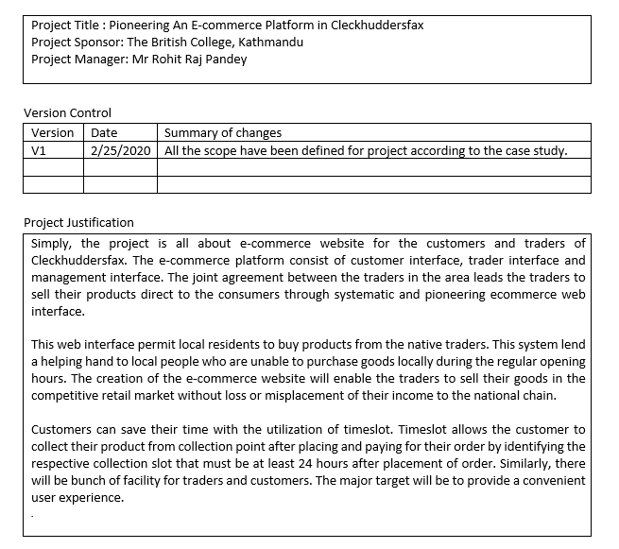

Project Charter Version 1
Project Justification

Slide 4
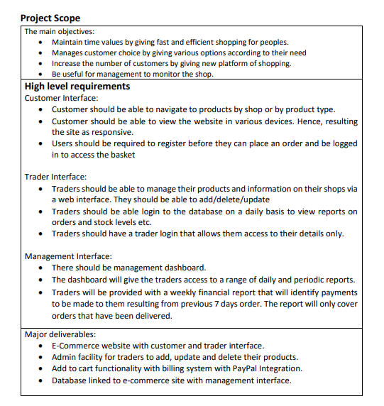
Project Charter Version 1
Trader Interface
Main Objectives
Management Interface
Project Scope
Customer Interface
Major Deliverables

Slide 5
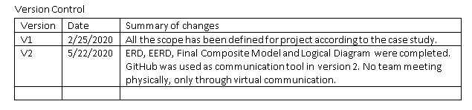
Project Charter Version 2
Version Control

Slide 6
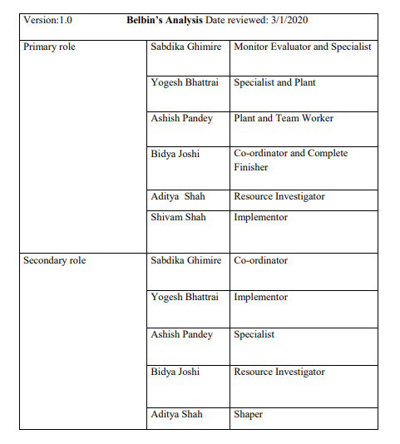

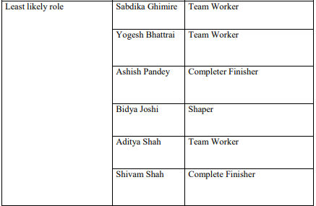
Project Planning Phase
Belbin’s Team Role

Slide 7
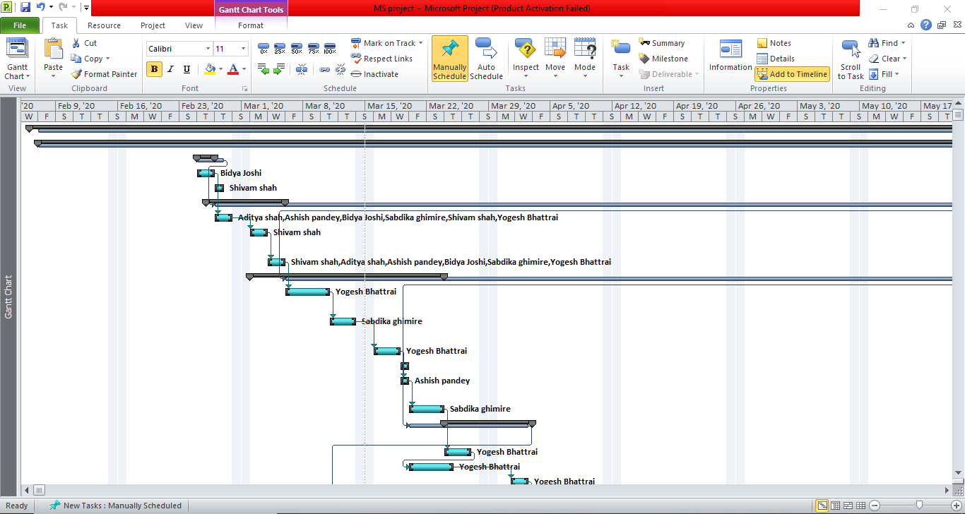
Microsoft Project
Gantt Chart 1
A Gantt chart, is a type of bar chart that illustrates a project schedule. This chart lists the tasks to be performed on the vertical axis, and time intervals on the horizontal axis.

Slide 8
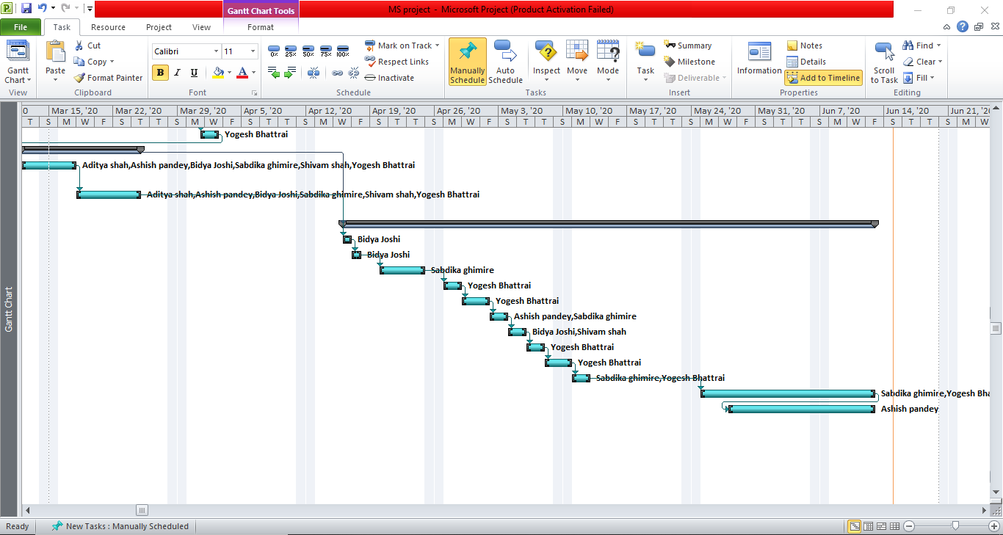
Microsoft Project
Gantt Chart 2
A Gantt chart, is a type of bar chart that illustrates a project schedule. This chart lists the tasks to be performed on the vertical axis, and time intervals on the horizontal axis.

Slide 9
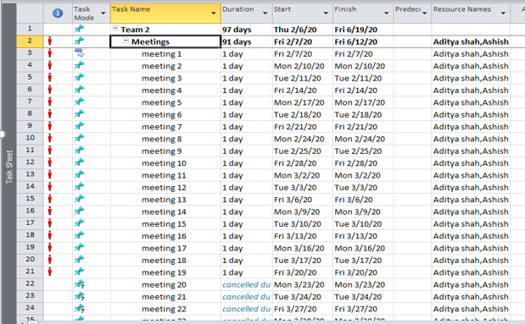
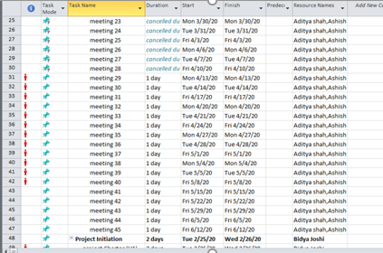
Microsoft Project
Project Task Sheet

Slide 10
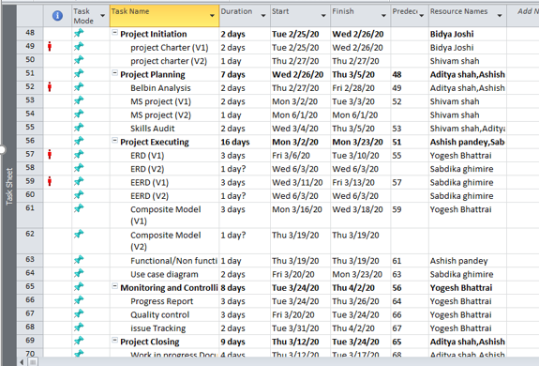
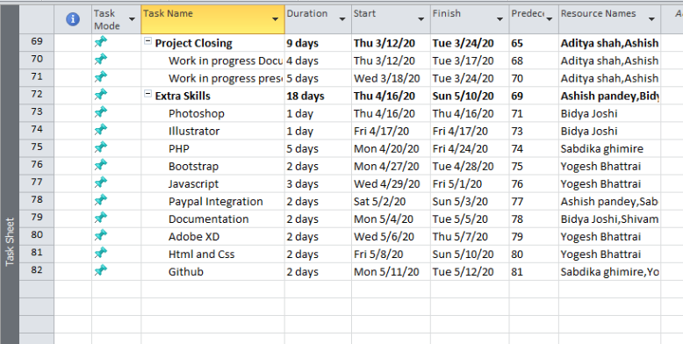
Microsoft Project
Project Task Sheet

Slide 11
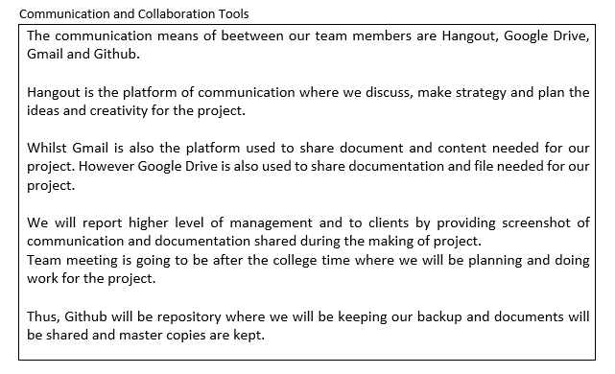




Communication Tools (Planning Phase)

Slide 12
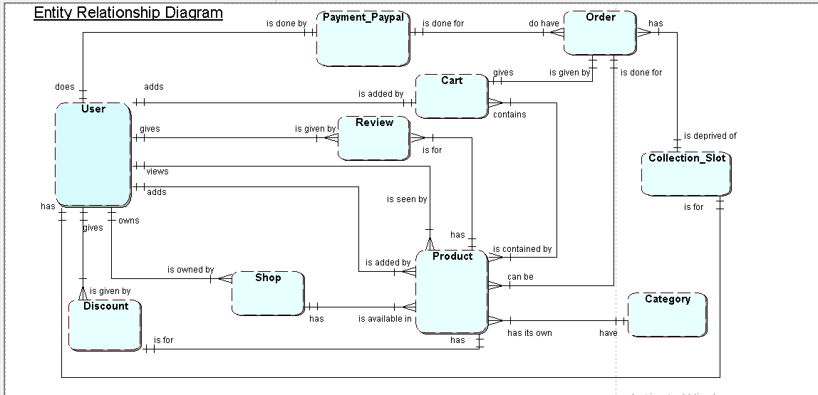
Entity Relationship Diagram Version 2

Slide 13
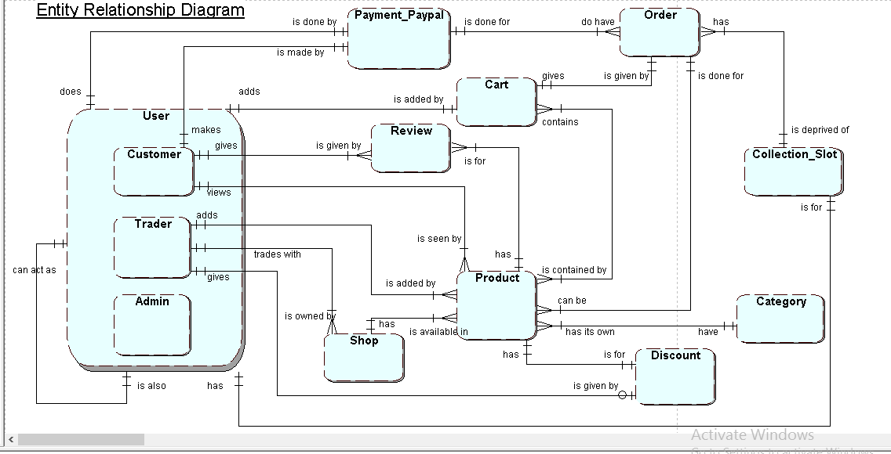
Extended Entity Relationship Diagram

Slide 14
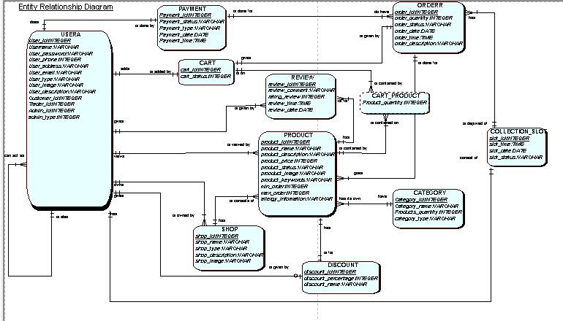
Final Composite Model

Slide 15
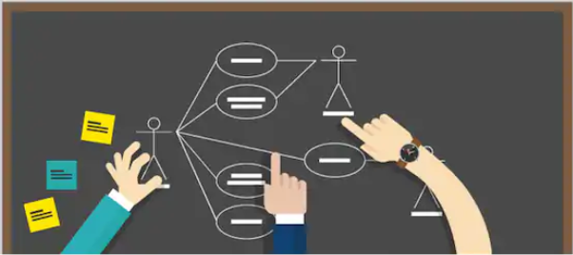
Use Case Diagram
Customer Use Case Diagram
Management Use Case Diagram
Use Case Diagram
Trader Use Case Diagram
Overview Use Case Diagram

Slide 16
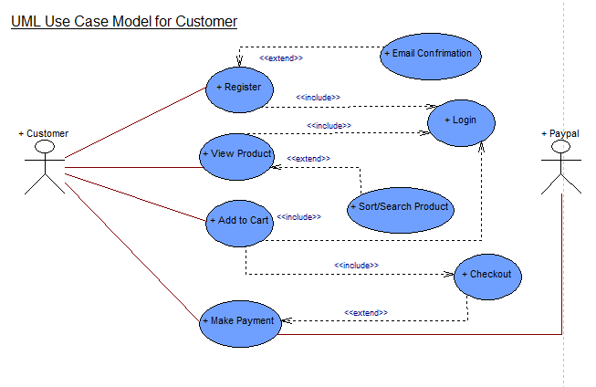
Customer Use Case Diagram

Slide 17
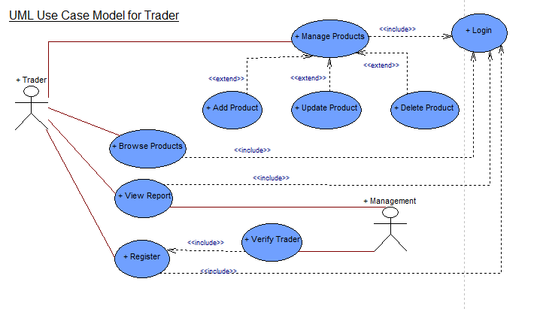
Trader Use Case Diagram

Slide 18
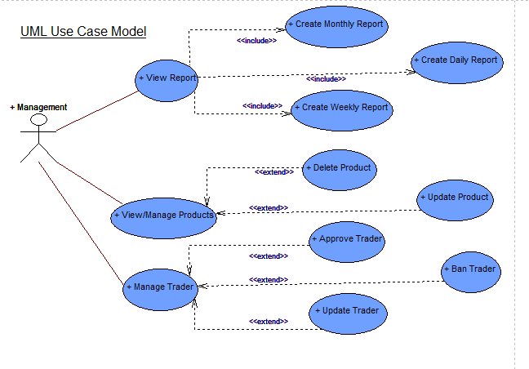
Management Use Case Diagram

Slide 19
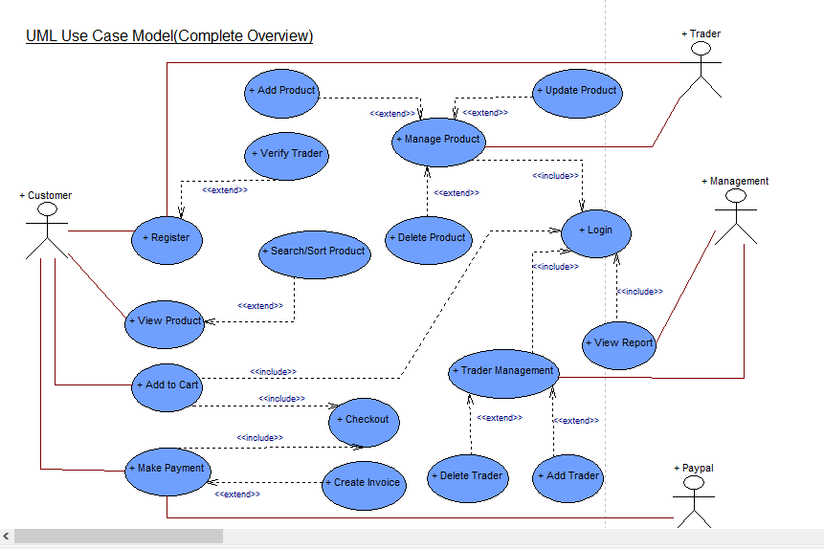
Overview Use Case Diagram

Slide 20
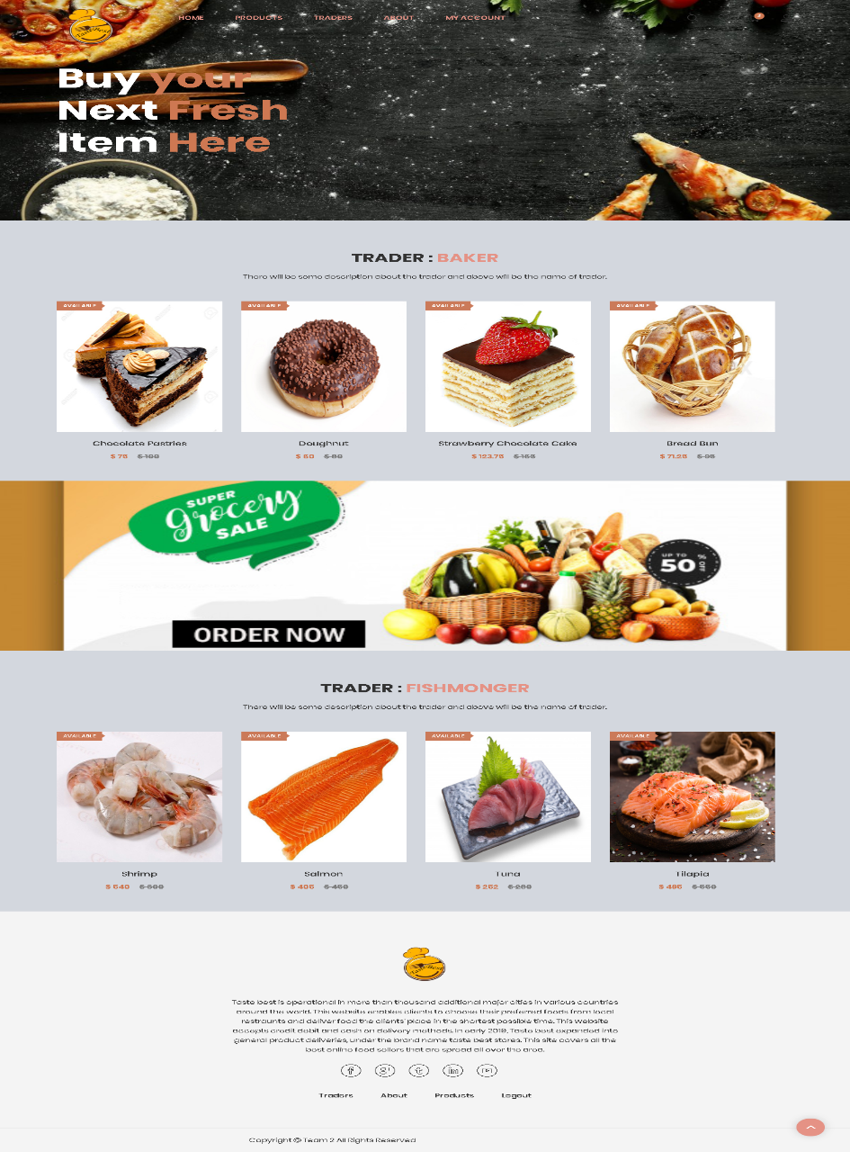
Website Demonstration
Continue..

Slide 21


